Slide 1

Energy Efficiency
Akash Singh

Slide 2
ABOUT THE DATASET
The dataset was created by Angeliki Xifara (angxifara '@' gmail.com, Civil/Structural Engineer) and was processed by Athanasios Tsanas (tsanasthanasis '@' gmail.com, Oxford Centre for Industrial and Applied Mathematics, University of Oxford, UK). Dataset available at https://archive.ics.uci.edu/ml/datasets/energy+efficiency
Attribute Information:
The dataset contains eight attributes (or features, denoted by X1...X8) and two responses (or outcomes, denoted by y1 and y2). The aim is to use the eight features to predict each of the two responses. for_ Specifically:
X1 Relative Compactness, X2 Surface Area, X3 Wall Area, X4 Roof Area, X5 Overall Height, X6 Orientation, X7 Glazing Area, X8 Glazing Area Distribution,
y1 Heating Load, y2 Cooling Load

Slide 3
Feature Engineering
Converting The Column Names Into - Relative Compactness, Surface Area, Wall Area, Roof Area, Overall Height, Orientation, Glazing Area, Glazing Area Distribution , Heating Load, Cooling Load
Relative Compactness | Surface Area | Wall Area | Roof Area | Overall Height | Orientation | Glazing Area | Glazing Area Distribution | Heating Load | Cooling Load
0 | 0.98 | 514.5 | 294.0 | 110.25 | 7.0 | 2.0 | 0.0 | 0.0 | 15.55 | 21.33
1 | 0.98 | 514.5 | 294.0 | 110.25 | 7.0 | 3.0 | 0.0 | 0.0 | 15.55 | 21.33
2 | 0.98 | 514.5 | 294.0 | 110.25 | 7.0 | 4.0 | 0.0 | 0.0 | 15.55 | 21.33
3 | 0.98 | 514.5 | 294.0 | 110.25 | 7.0 | 5.0 | 0.0 | 0.0 | 15.55 | 21.33
4 | 0.90 | 563.5 | 318.5 | 122.50 | 7.0 | 2.0 | 0.0 | 0.0 | 20.84 | 28.28

Slide 4
Feature Engineering
Data Shape – (1296X1O)
There are 528 missing values in the dataset . I’m dropping them all .
Adding up a new column as ‘Overall Load’ . It’s a joint of the column of Heating Load & Cooling Load .
Relative Compactness | Surface Area | Wall Area | Roof Area | Overall Height | Orientation | Glazing Area | Glazing Area Distribution | Heating Load | Cooling Load | Overall Load
0 | 0.98 | 514.5 | 294.0 | 110.25 | 7.0 | 2.0 | 0.0 | 0.0 | 15.55 | 21.33 | 36.88
1 | 0.98 | 514.5 | 294.0 | 110.25 | 7.0 | 3.0 | 0.0 | 0.0 | 15.55 | 21.33 | 36.88

Slide 5
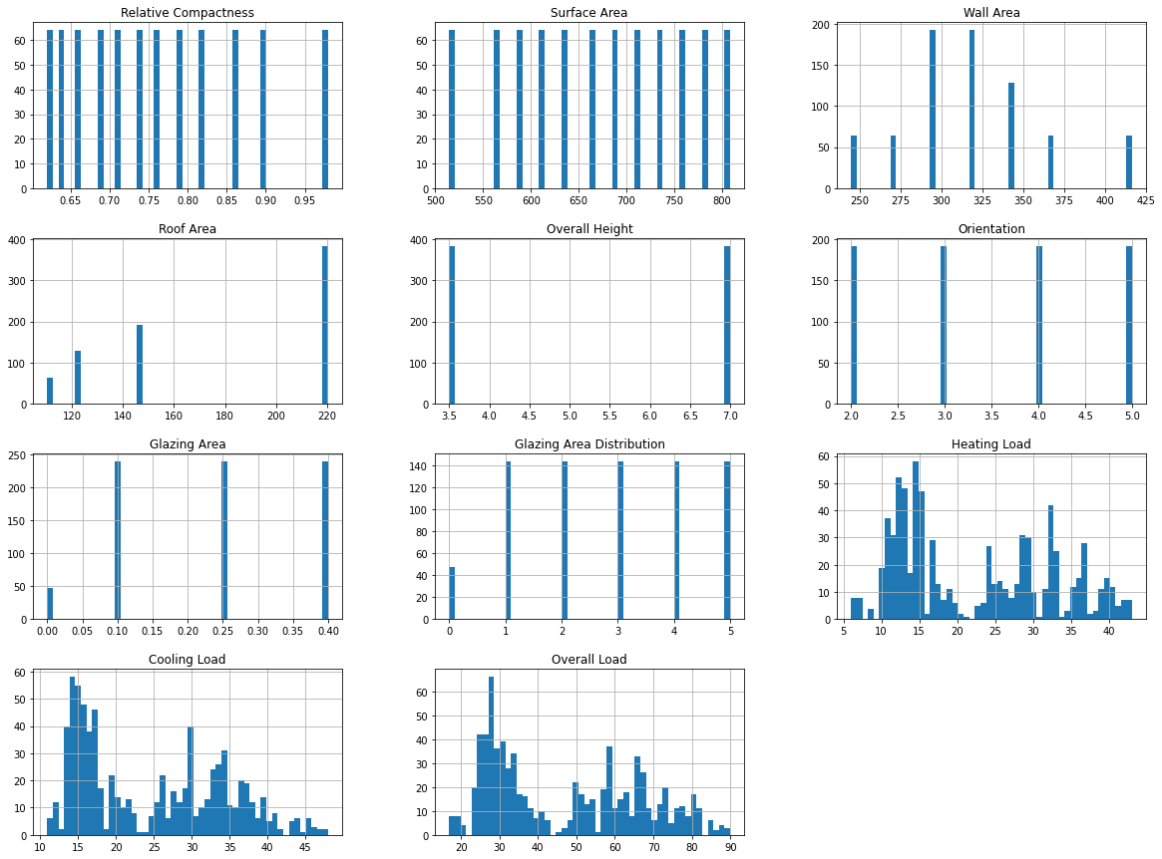
Exploratory Data Analysis
Histogram Plotting Of All The Dataset

Slide 6
CORRELATION
Relative Compactness | Surface Area | Wall Area | Roof Area | Overall Height | Orientation | Glazing Area | Glazing Area Distribution | Heating Load | Cooling Load | Overall Load
Relative Compactness | 1.000000e+00 | -9.919015e-01 | -2.037817e-01 | -8.688234e-01 | 8.277473e-01 | 4.678592e-17 | -2.960552e-15 | -7.107006e-16 | 0.622272 | 0.634339 | 0.631950
Surface Area | -9.919015e-01 | 1.000000e+00 | 1.955016e-01 | 8.807195e-01 | -8.581477e-01 | -3.459372e-17 | 3.636925e-15 | 2.438409e-15 | -0.658120 | -0.672999 | -0.669389
Wall Area | -2.037817e-01 | 1.955016e-01 | 1.000000e+00 | -2.923165e-01 | 2.809757e-01 | -2.429499e-17 | -8.567455e-17 | 2.067384e-16 | 0.455671 | 0.427117 | 0.444502
Roof Area | -8.688234e-01 | 8.807195e-01 | -2.923165e-01 | 1.000000e+00 | -9.725122e-01 | -5.830058e-17 | -1.759011e-15 | -1.078071e-15 | -0.861828 | -0.862547 | -0.867423
Overall Height | 8.277473e-01 | -8.581477e-01 | 2.809757e-01 | -9.725122e-01 | 1.000000e+00 | 4.492205e-17 | 1.489134e-17 | -2.920613e-17 | 0.889431 | 0.895785 | 0.897945
Orientation | 4.678592e-17 | -3.459372e-17 | -2.429499e-17 | -5.830058e-17 | 4.492205e-17 | 1.000000e+00 | -9.406007e-16 | -2.549352e-16 | -0.002587 | 0.014290 | 0.005637
Glazing Area | -2.960552e-15 | 3.636925e-15 | -8.567455e-17 | -1.759011e-15 | 1.489134e-17 | -9.406007e-16 | 1.000000e+00 | 2.129642e-01 | 0.269841 | 0.207505 | 0.241048
Glazing Area Distribution | -7.107006e-16 | 2.438409e-15 | 2.067384e-16 | -1.078071e-15 | -2.920613e-17 | -2.549352e-16 | 2.129642e-01 | 1.000000e+00 | 0.087368 | 0.050525 | 0.069911
Heating Load | 6.222722e-01 | -6.581202e-01 | 4.556712e-01 | -8.618283e-01 | 8.894307e-01 | -2.586534e-03 | 2.698410e-01 | 8.736759e-02 | 1.000000 | 0.975862 | 0.994299
Cooling Load | 6.343391e-01 | -6.729989e-01 | 4.271170e-01 | -8.625466e-01 | 8.957852e-01 | 1.428960e-02 | 2.075050e-01 | 5.052512e-02 | 0.975862 | 1.000000 | 0.993585
Overall Load | 6.319499e-01 | -6.693889e-01 | 4.445024e-01 | -8.674227e-01 | 8.979448e-01 | 5.637309e-03 | 2.410480e-01 | 6.991125e-02 | 0.994299 | 0.993585 | 1.000000

Slide 7
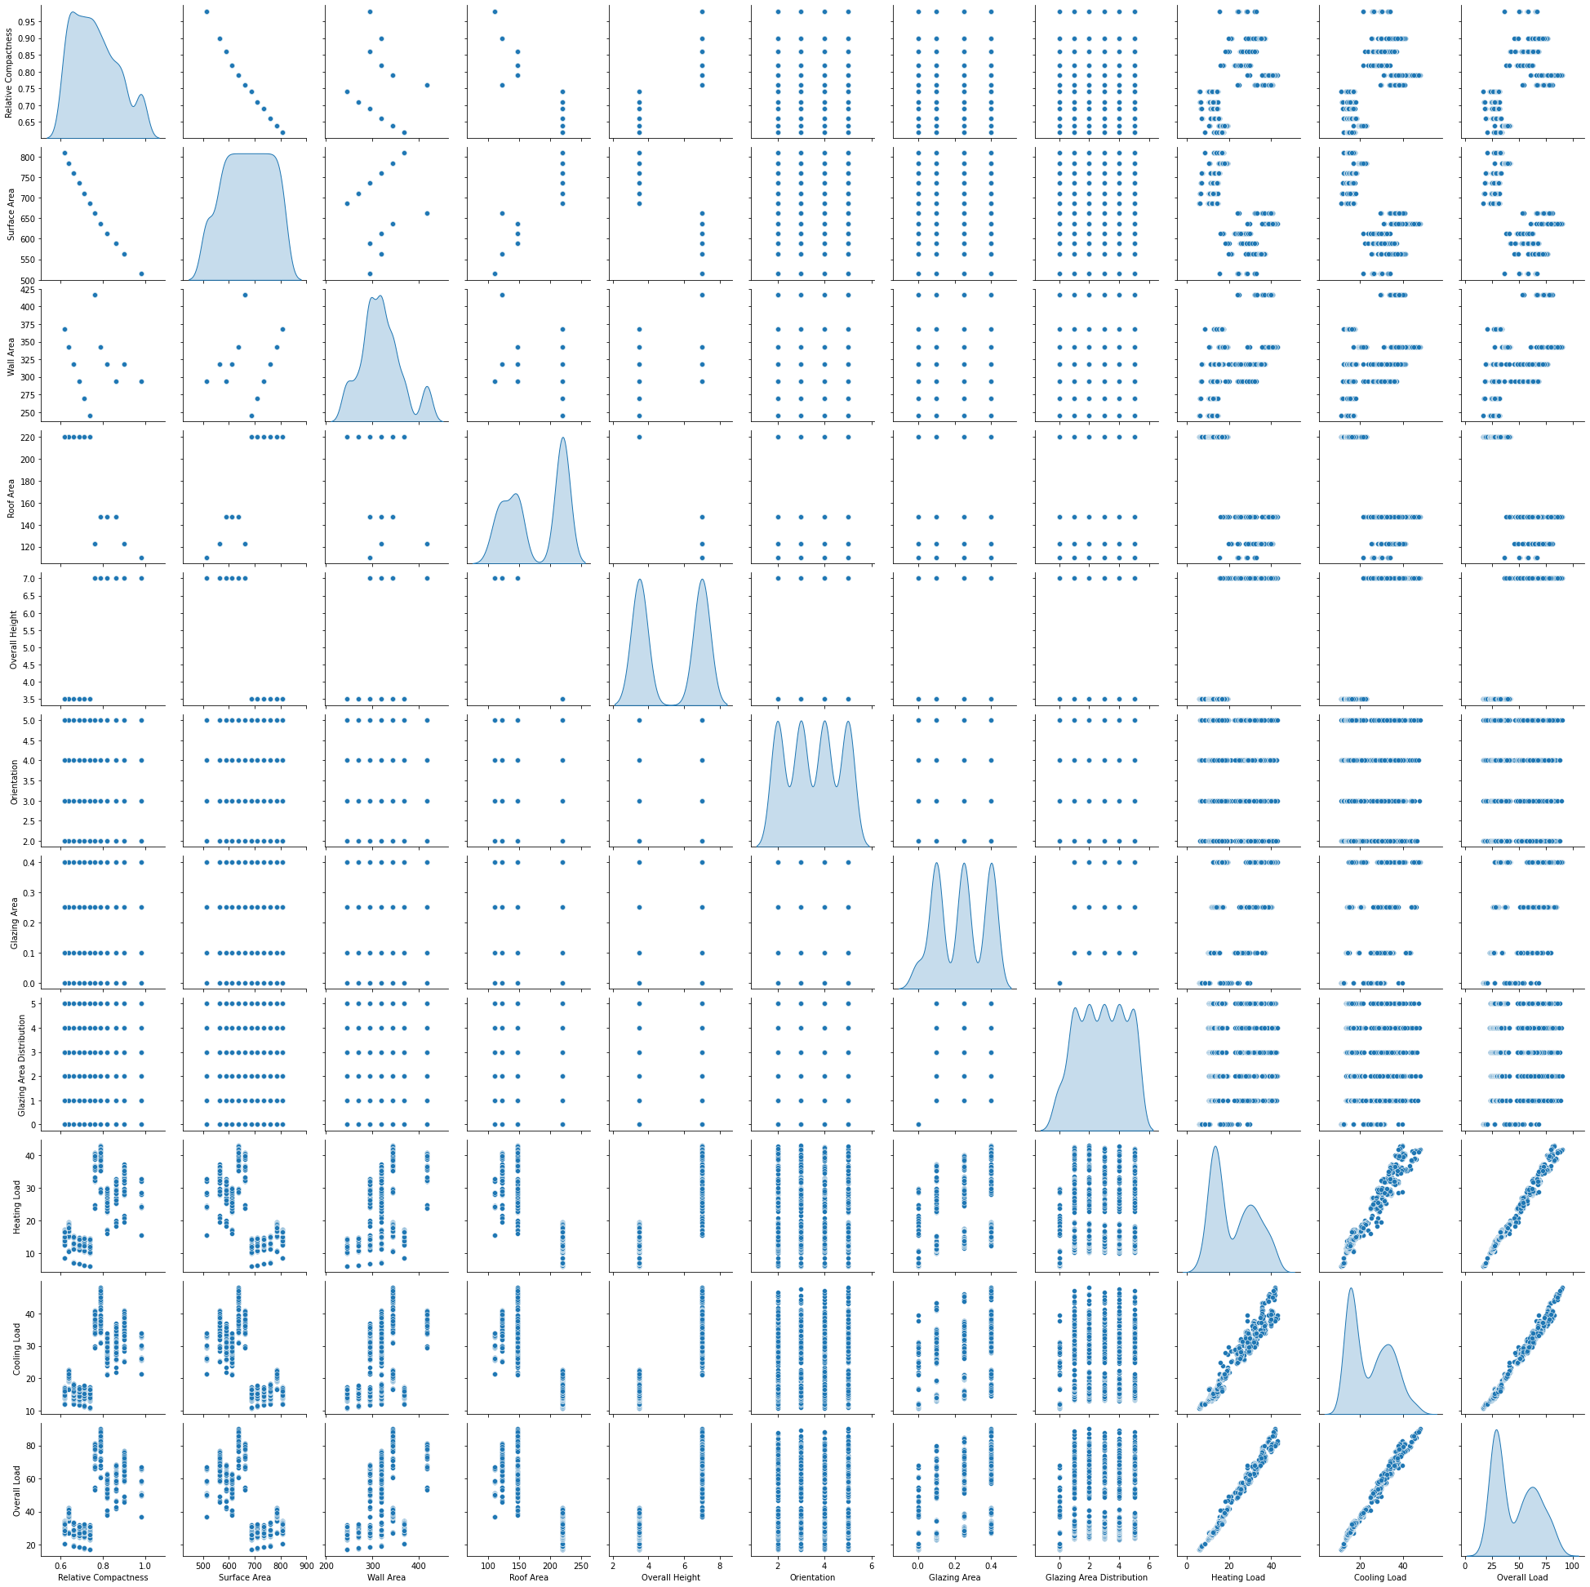
Scatter Plot Distribution Of The Data

Slide 8
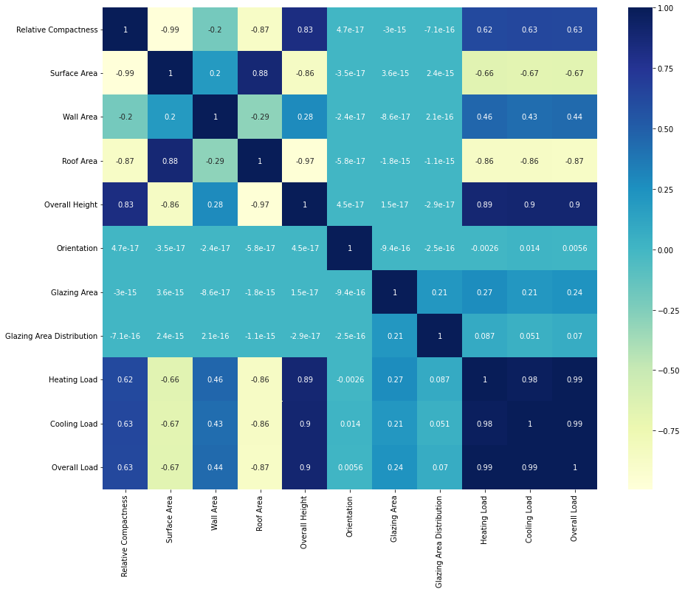
Heatmap Of The Data

Slide 9
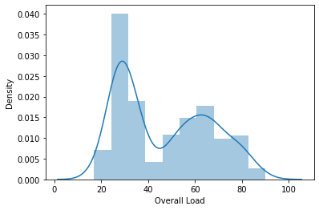
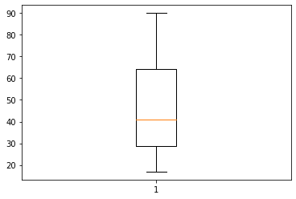
Trend Of ‘Overall load’
QUANTILES
0.25 28.750
0.50 40.970
0.75 64.335

Slide 10
Feature Engineering
Adding column for classes for efficiency
If the Overall load is below 29 it is considered as low .
If the Overall Load Is above 29 and below 64 it will be considered as average .
Otherwise It will be considered as high .
Average 368
Low 207
High 193

Slide 11
Feature Selection
Creating Column For Predicting Heating Load –
We Are Considering All The Dataset Except Cooling Load , Overall Load & Efficiency Column .
Creating Column For Predicting Cooling Load –
We Are Considering All The Dataset Except Heating Load , Overall Load & Efficiency Column .
Creating Column For Predicting Efficiency Classification –
We Are Considering All The Dataset Except Heating Load , Overall Load & Cooling Load .

Slide 12
Models For Predicting Heating Load
Linear Regression : - 0.91
KNN Regressor : - 0.92
Ridge: - 0.91
Lasso : - 0.91
Polynomial : - 0.994
Polynomial with Ridge: - 0.9362
Linear SVR : - 0.91
SVM : - 0.97
Decision Tree : - 0.9966
Best Base Regression Model :- Decision Tree with R Square= 0.9966

Slide 13
Ensemble Models For Predicting Heating Load
Random Forest: - 0.95
Bagging(KNN) : - 0.86
Pasting(KNN) : - 0.89
Bagging(Linear SVR) : - 0.88
Pasting(Linear SVR) : - 0.91
Bagging(SVR) : - 0.91
Pasting(SVR) : - 0.92
Bagging(Decision Tree): - 0.96
Pasting(Decision Tree): - 0.92
Adaptive Boosting (Decision Tree) : - 0.9969
Adaptive Boosting (Random Forest) : - 0.97
Adaptive Boosting (SVM Regressor) : - 0.94
Gradient Boosting : - 0.9982
Best Ensemble Regression Model for Heating Load :- Gradient Boosting with R Square= 0.998

Slide 14
Models For Predicting Cooling Load
Linear Regression : - 0.89
KNN Regressor : - 0.91
Ridge: - 0.89
Lasso : - 0.89
Polynomial : - 0.9639
Polynomial with Ridge: - 0.90
Linear SVR : - 0.88
SVM : - 0.91
Decision Tree : - 0.9650
Best Base Regression Model for Cooling Load :- Decision Tree with R Square= 0.9650

Slide 15
Summary of R- Square Scores for Ensemble Regression Models for Cooling Load
Bagging(Decision Tree): - 0.95
Pasting(Decision Tree): - 0.89
Adaptive Boosting (Decision Tree) : - 0.9661
Adaptive Boosting (Random Forest) : - 0.9438
Adaptive Boosting (SVM Regressor) : - 0.92
Gradient Boosting : - 0.9863
Random Forest: - 0.93
Bagging(KNN) : - 0.84
Pasting(KNN) : - 0.86
Bagging(Linear SVR) : - 0.87
Pasting(Linear SVR) : - 0.88
Bagging(SVR) : - 0.88
Pasting(SVR) : - 0.89
Best Ensemble Regression Model for Cooling Load :- Gradient Boosting with R Square= 0.9863

